Slide 1



Slide 2

Done By:
Santosh Varun Karnati (18031J0004)
Subha Sri Vadlamudi(18031J0081)
Goutham Krishna Belide(18031J0015)
Sai Lahari Seethamraju(18031J0053)
Kalki Dev Ippili(18031J0057)
Alekhya Vedantam(18031J0049)
User Application
Hotel Application
Delivery Application
Guided by: Sri Devi Katta

Slide 3
Objective
The online food delivering app is a web and mobile application designed primarily for the use in the food industry.
Our system also quickly guides and easily manage an online menu which customers can browse and use to place orders with just few clicks. Customers can track their order with an ease which improves the food delivery service. All the applications are based on android.
To implement this project, three different mobile applications are designed using Ionic framework(hybrid technology) for the customers, hotels and food delivery services respectively. Using,
Angular
typescript
ionic framework
Firebase

Slide 4
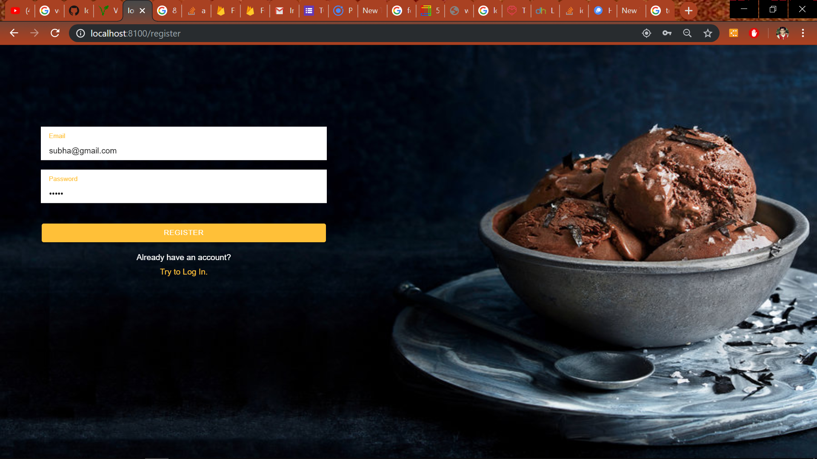
User Application

Slide 5
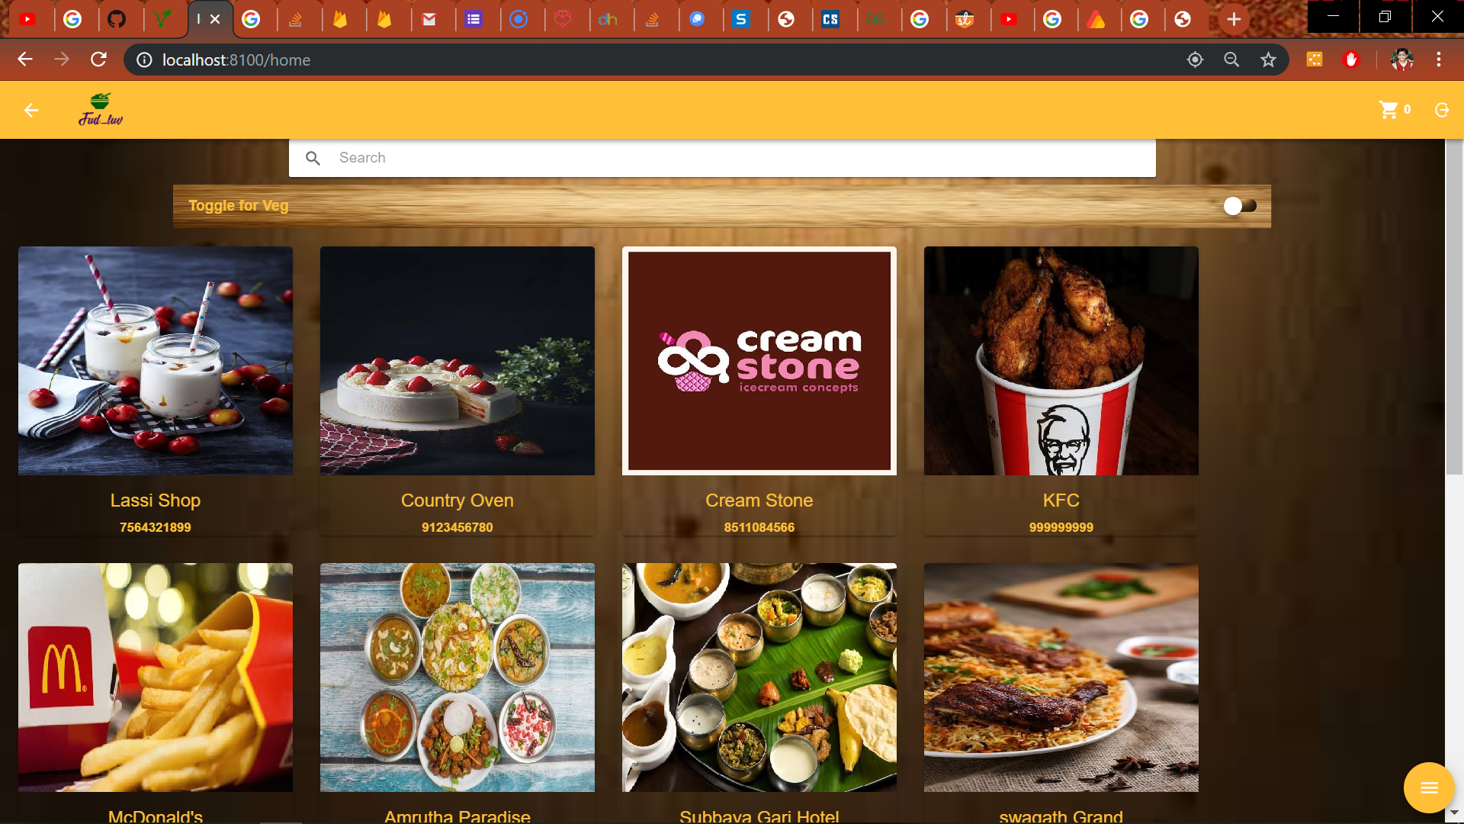

Slide 6
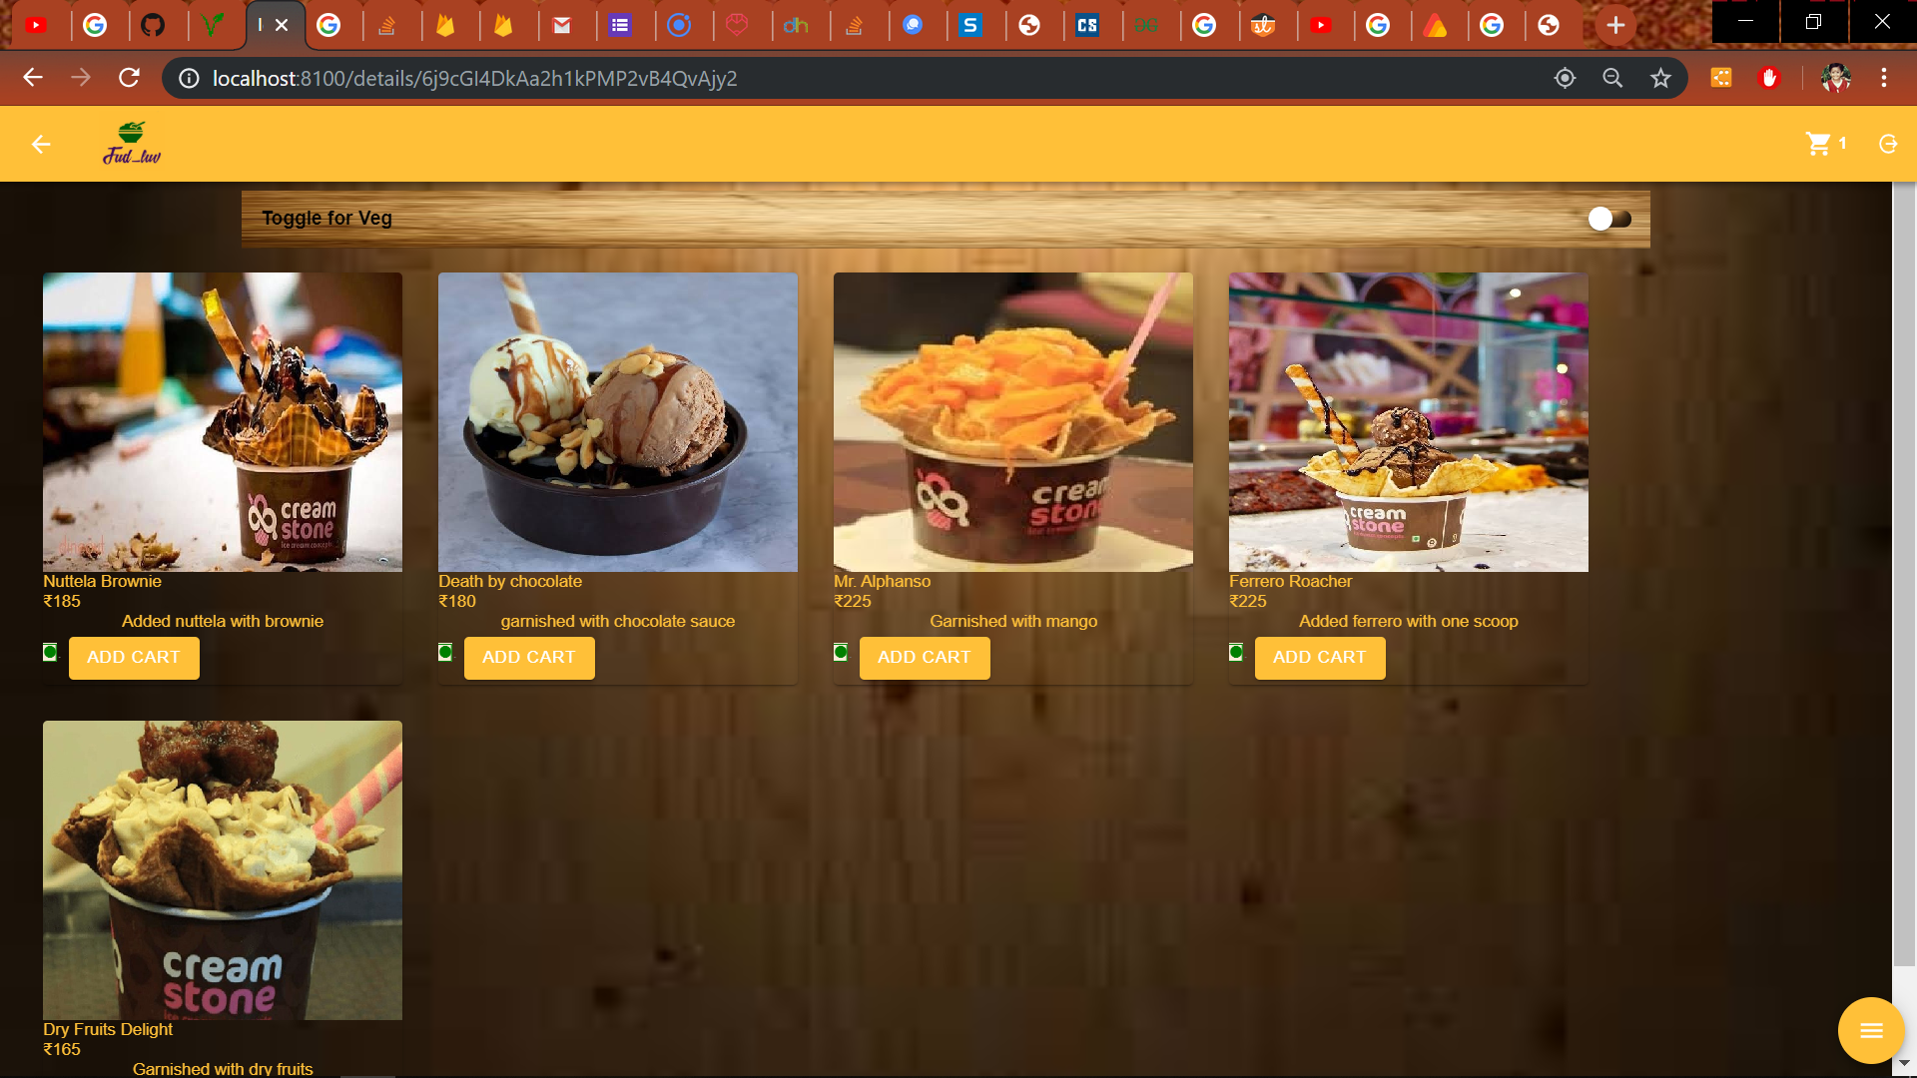

Slide 7
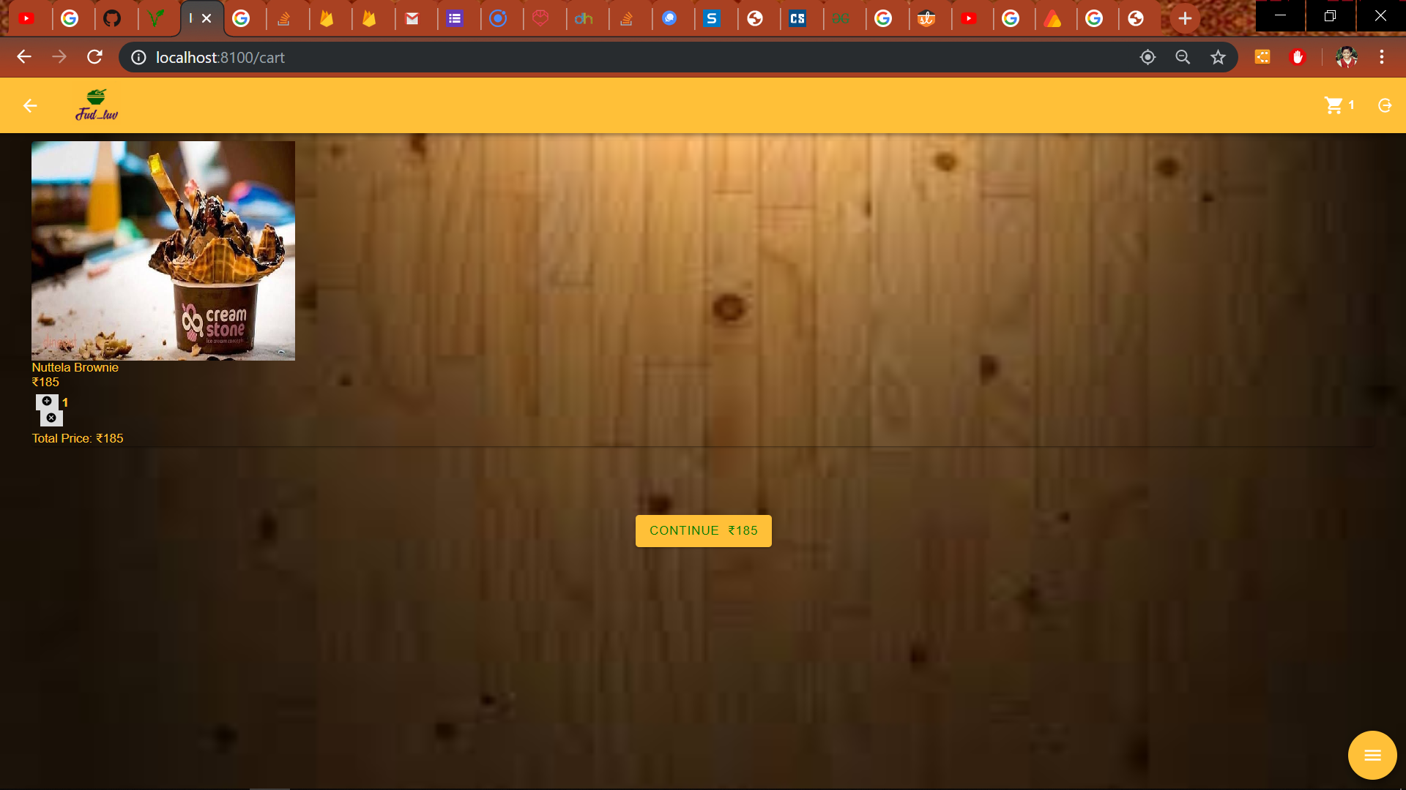

Slide 8
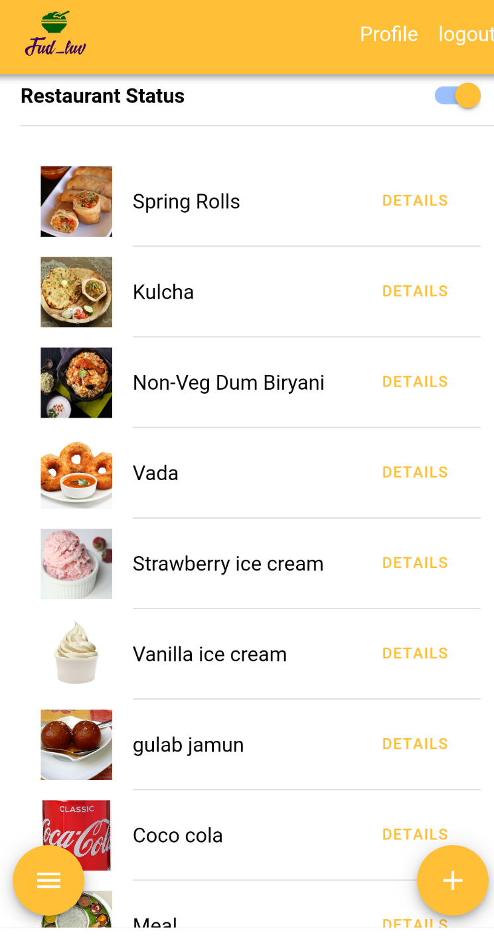
Hotel Application

Slide 9
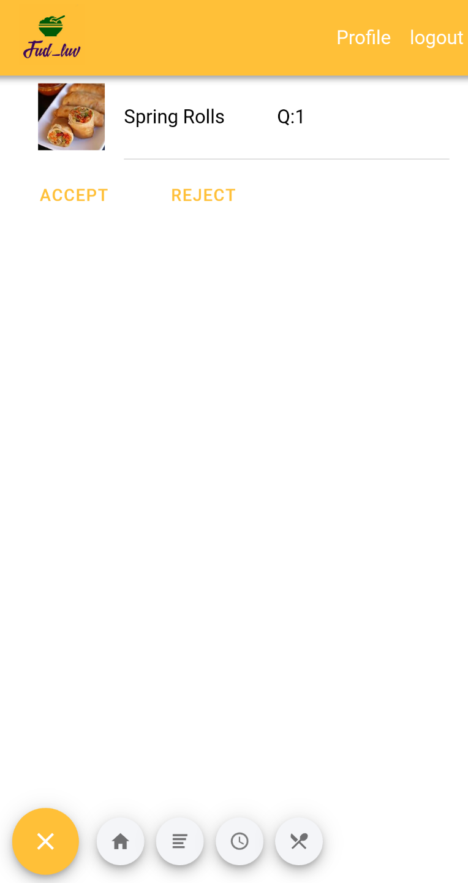

Slide 10
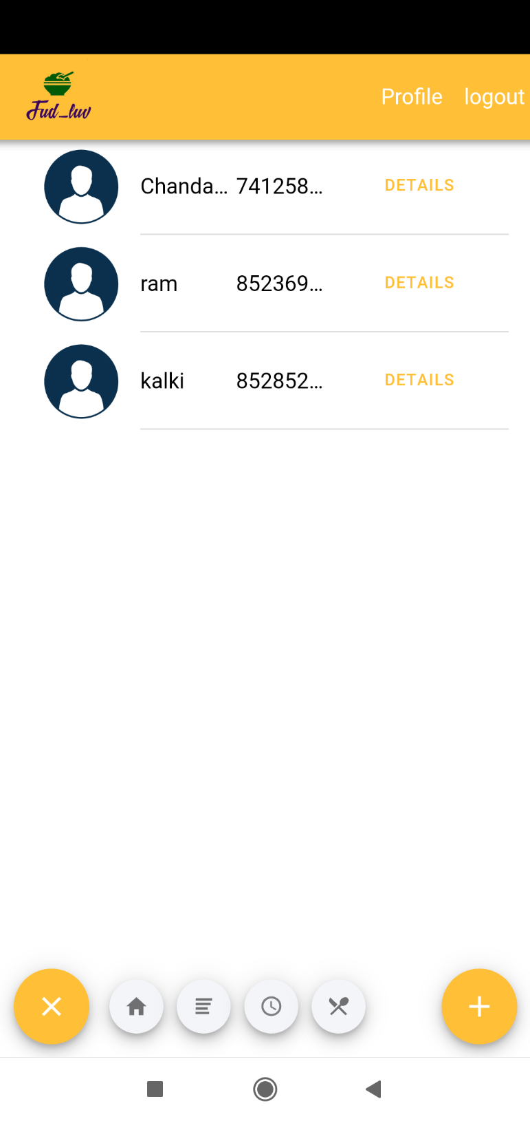

Slide 11
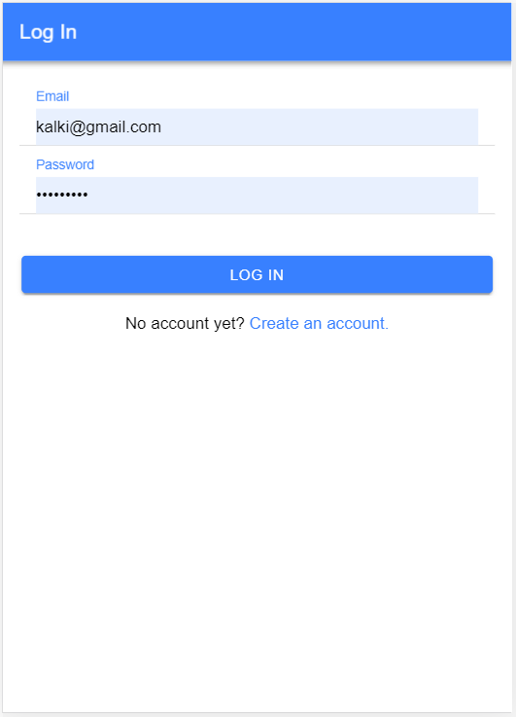
Delivery App

Slide 12
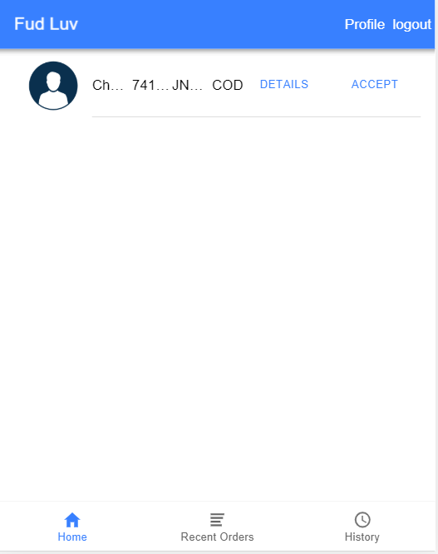

Slide 13
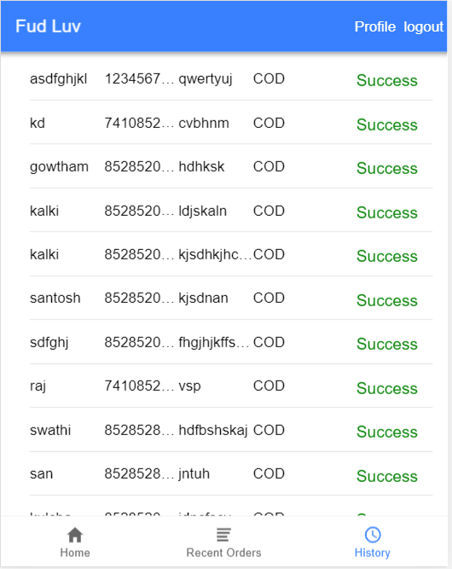

Slide 14
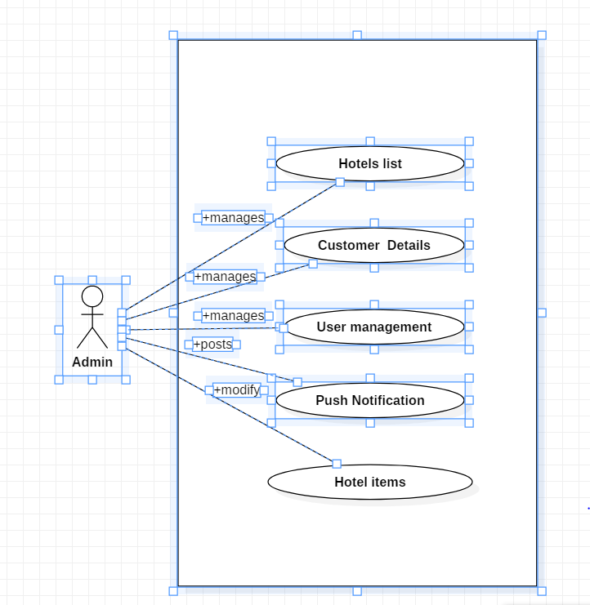
Admin use case diagram

Slide 15
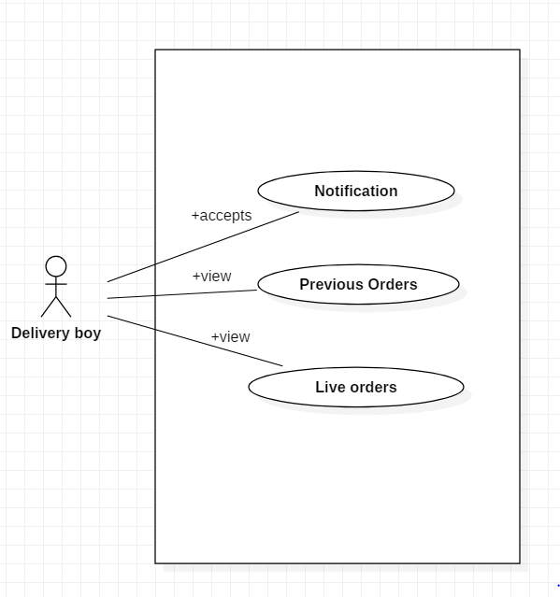
Delivery use case diagram

Slide 16
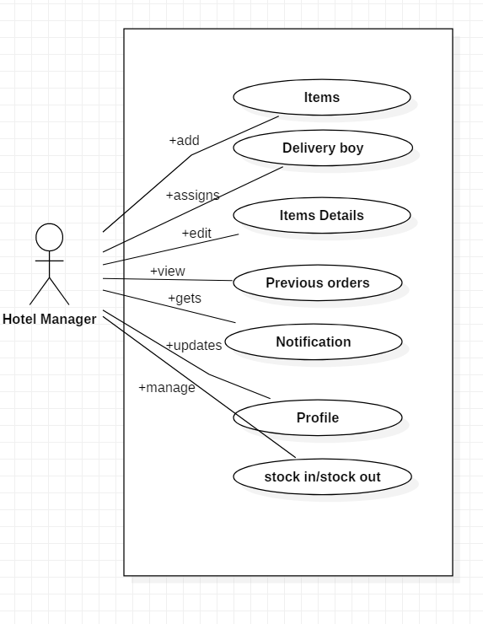
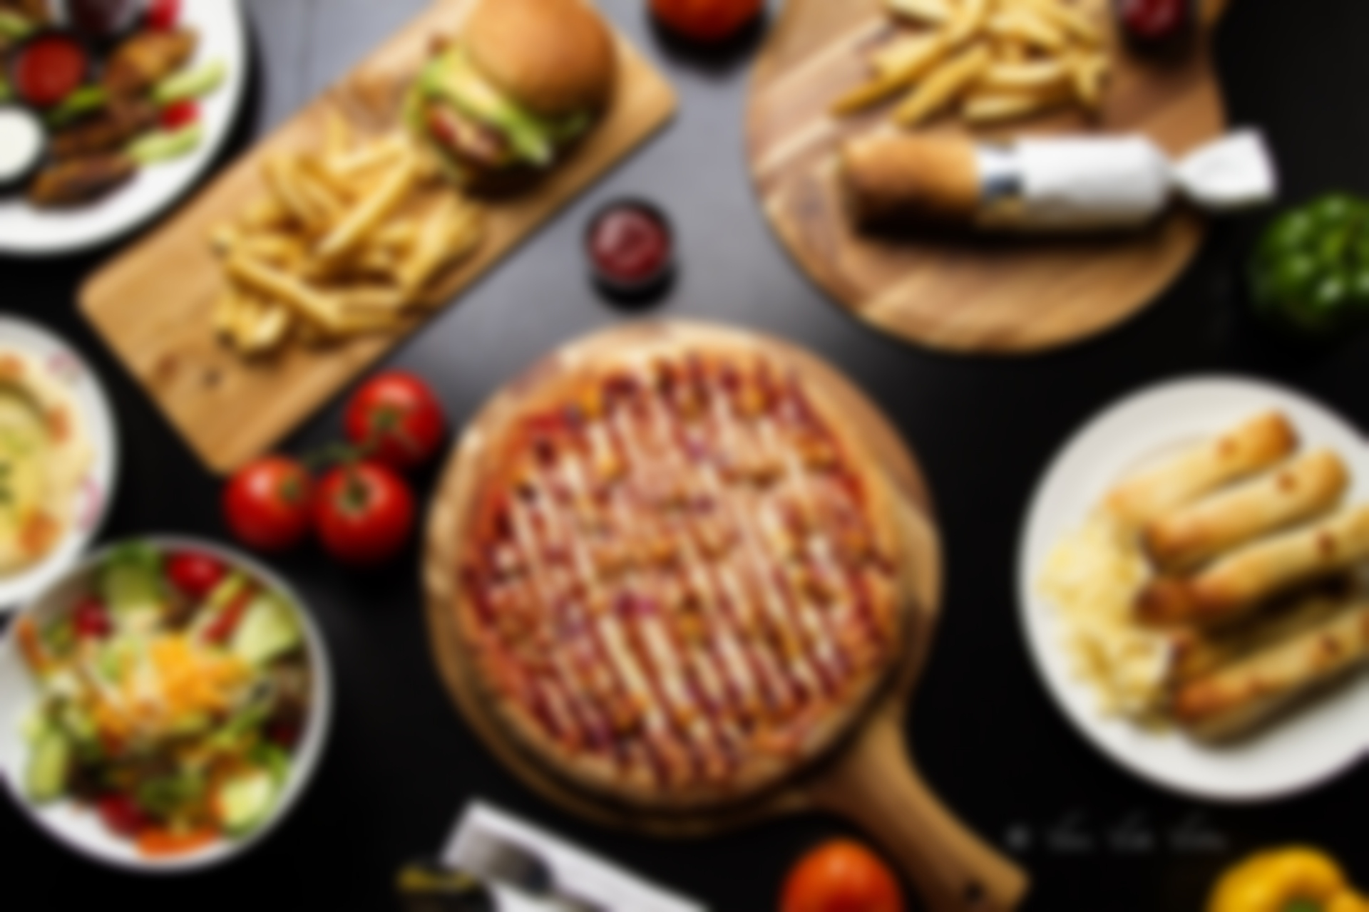
Hotel use case diagram

Slide 17
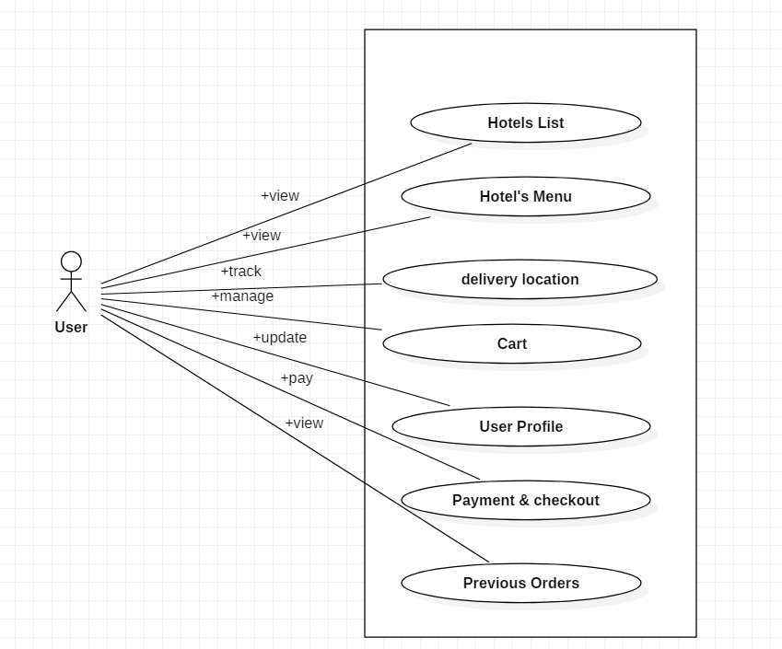
User use case diagram

Slide 18
Highlights:
The added feature of our app is that it takes orders from multiple restaurants simultaneously.

Slide 19
Future Enhancement
Chat option
Feedback
Push Notifications
Data visualization

Slide 20

Thank you

